Slide 1
NVSim and Destiny Simulator Comparison on RAM Cells

Slide 2

The Code Strategy

Slide 3
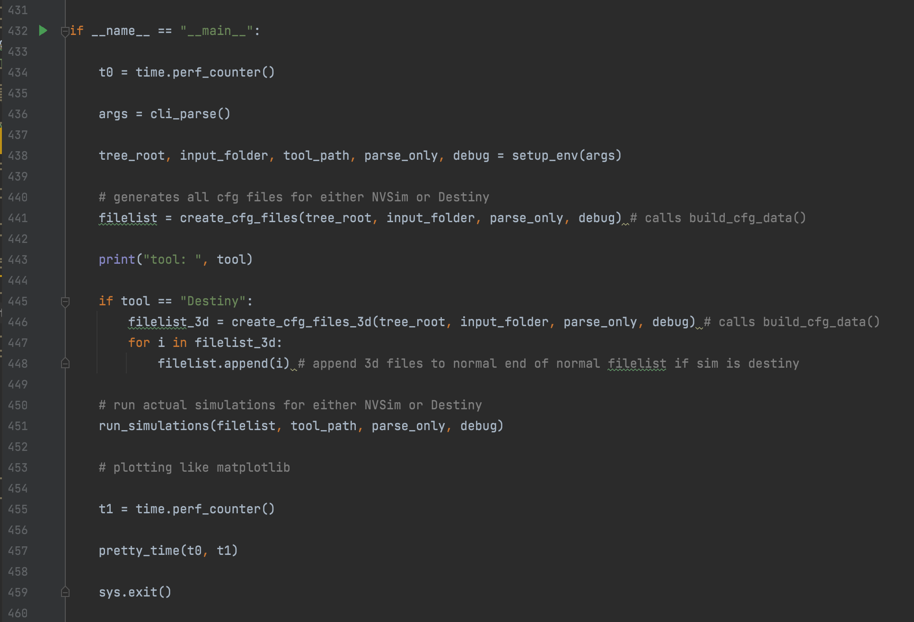
Code Overview

Slide 4
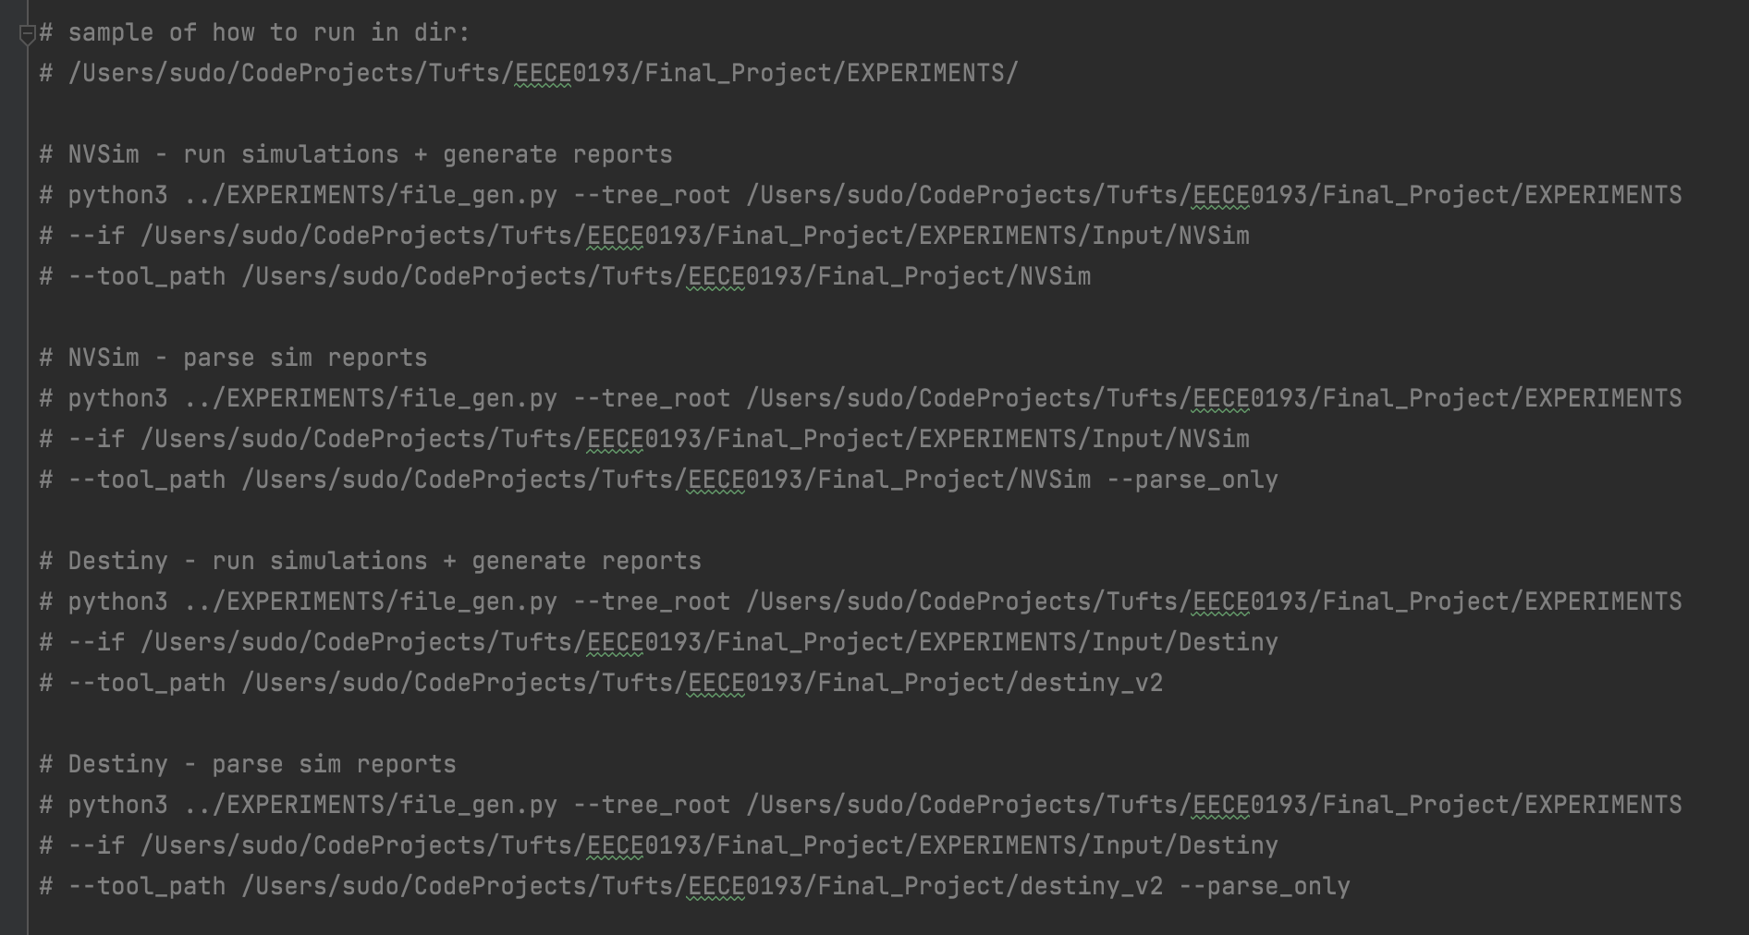

Slide 5
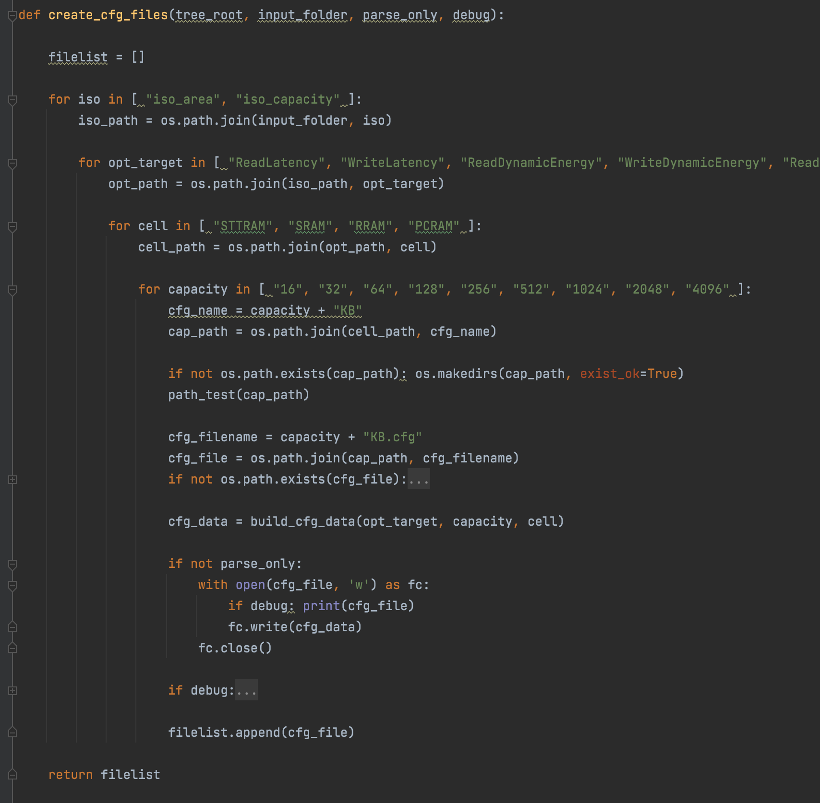
Step 1: Environment Creation Config Files

Slide 6
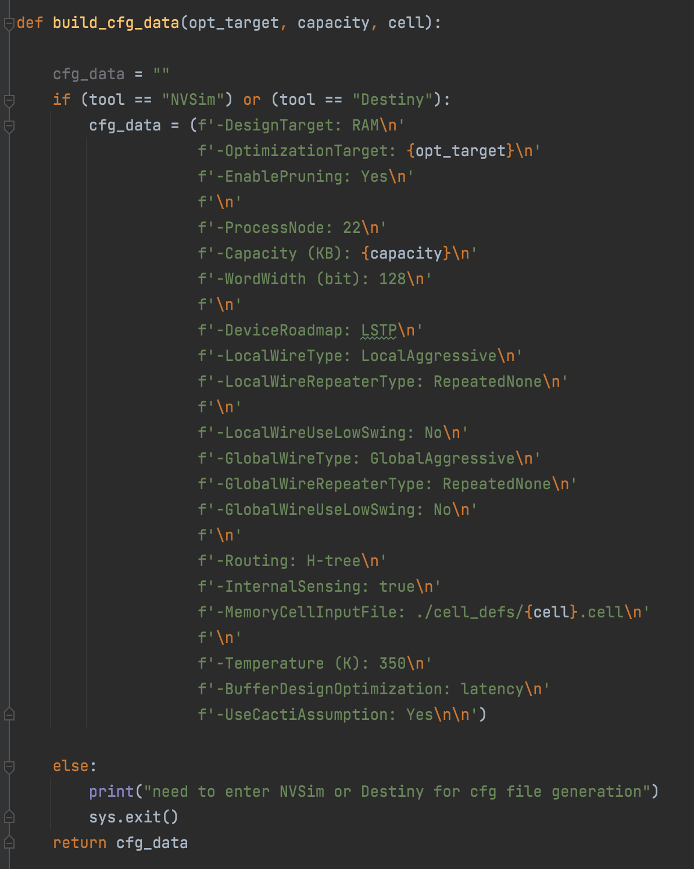
Step 1 continued:
Config Files

Slide 7
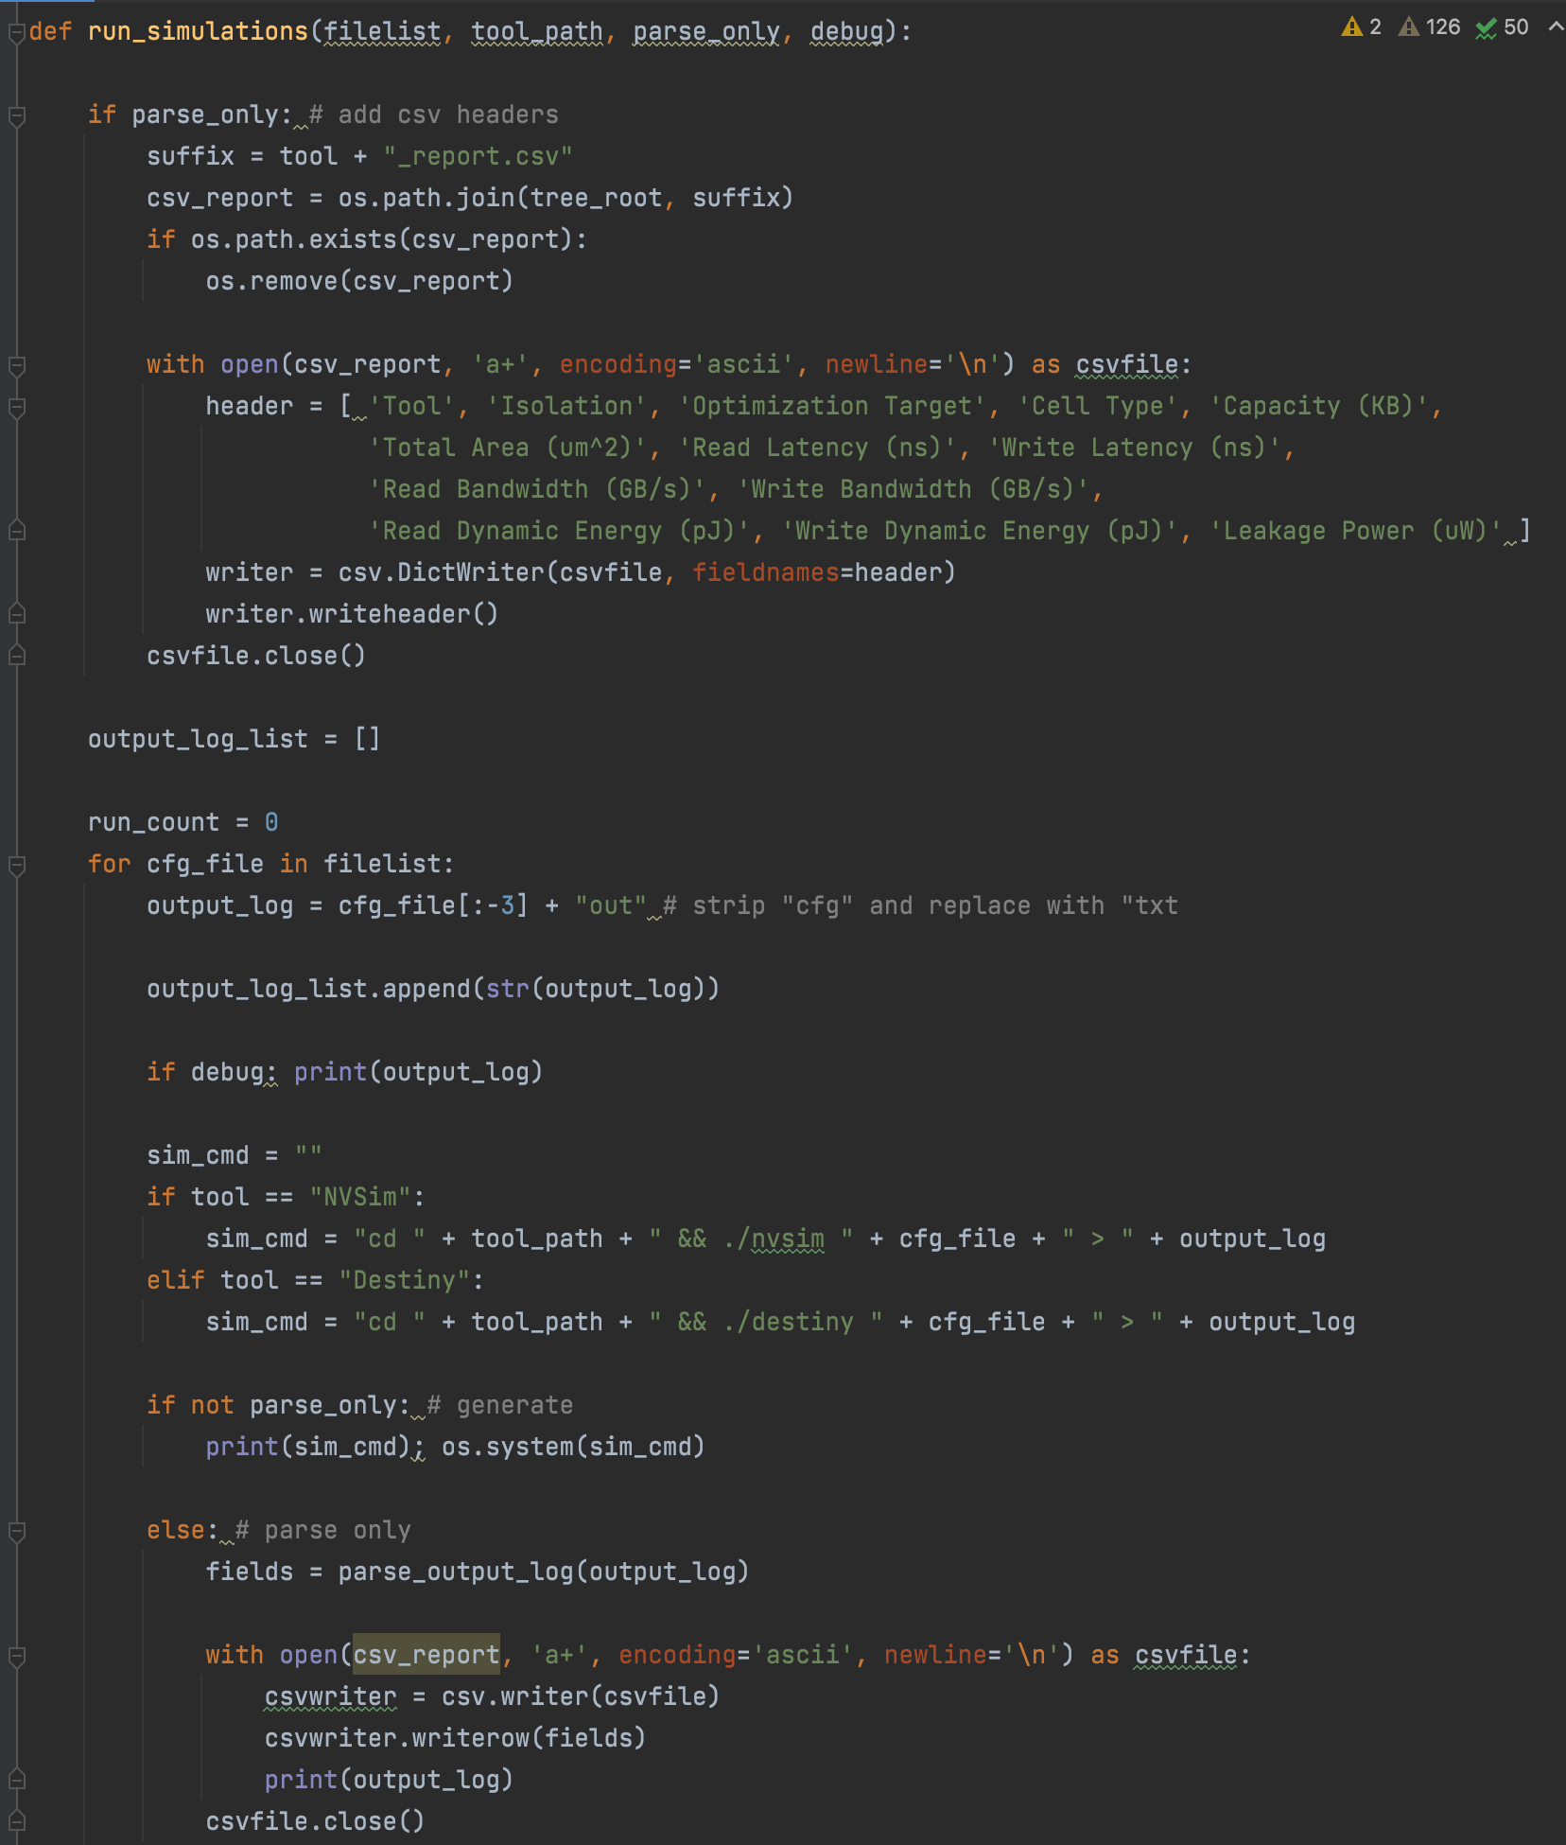
Step 2:
Simulations

Slide 8
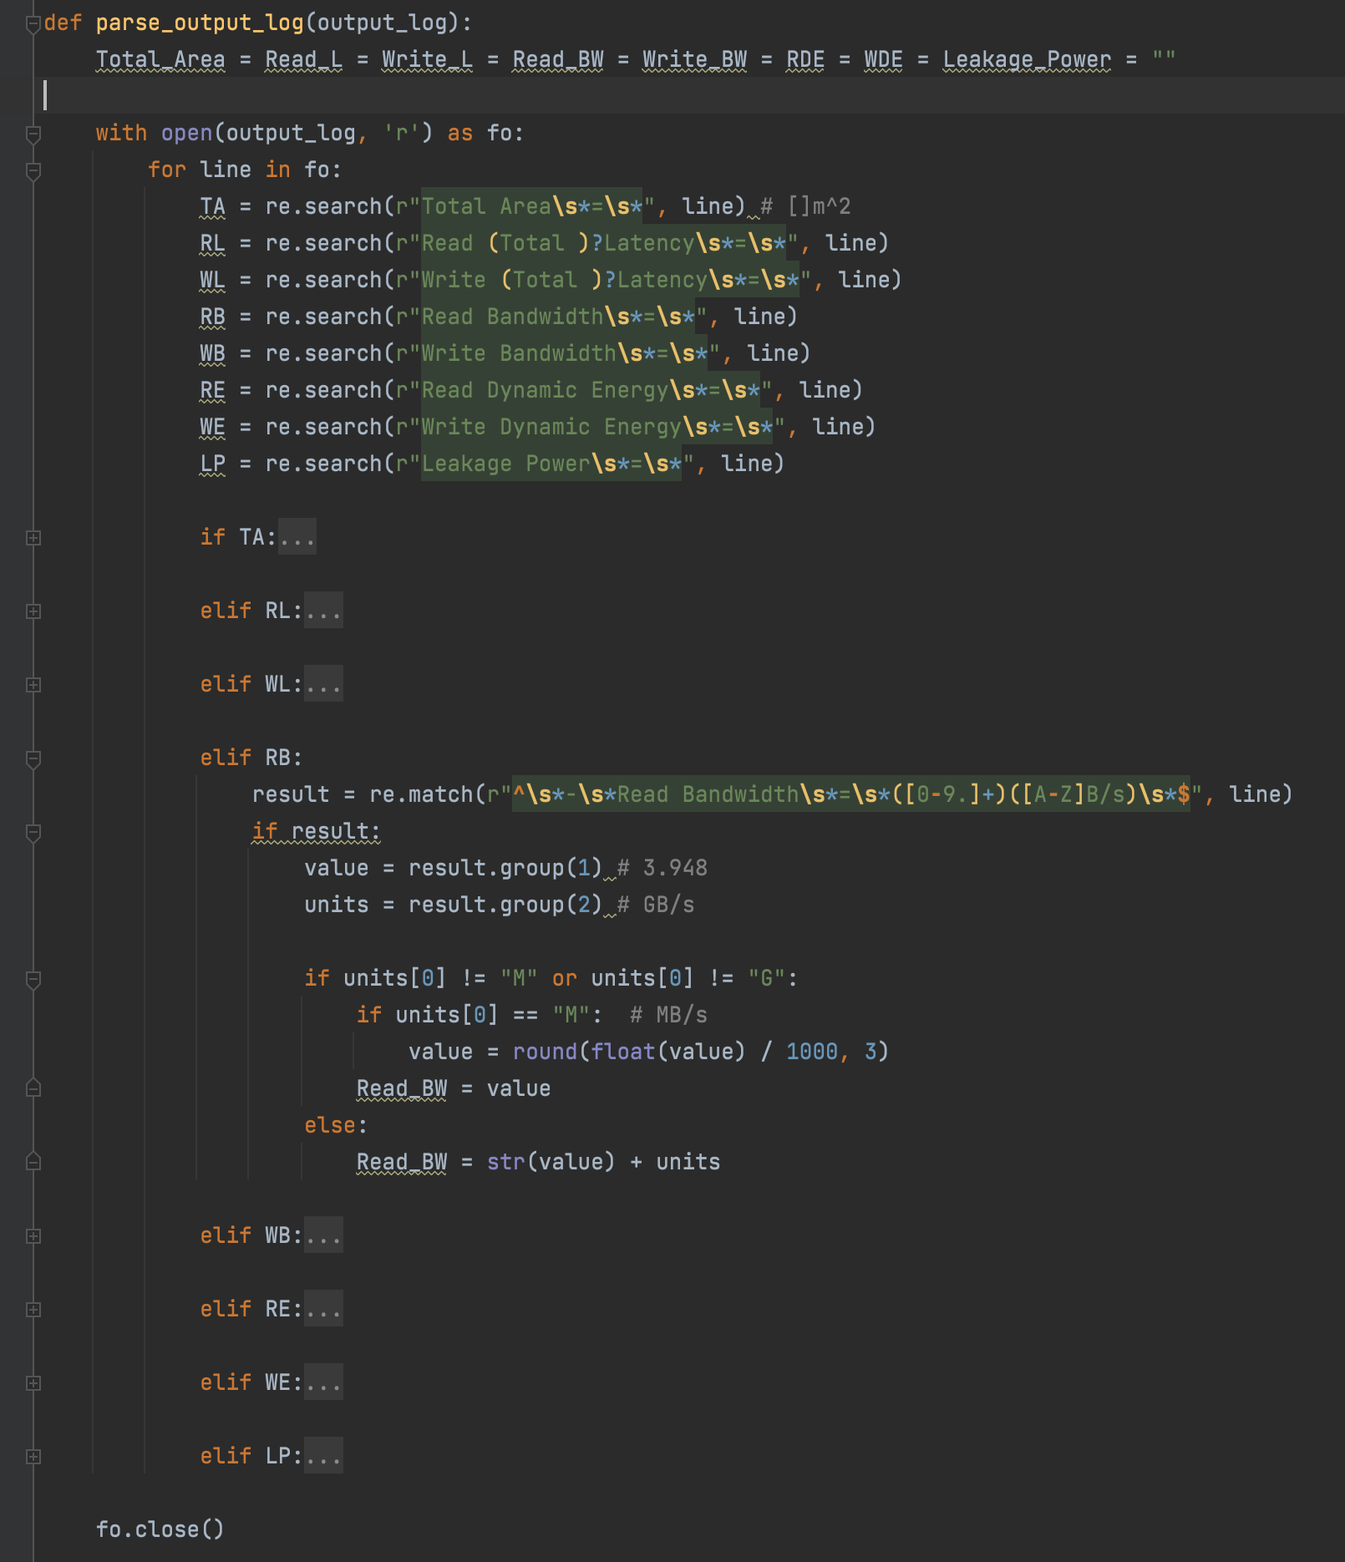
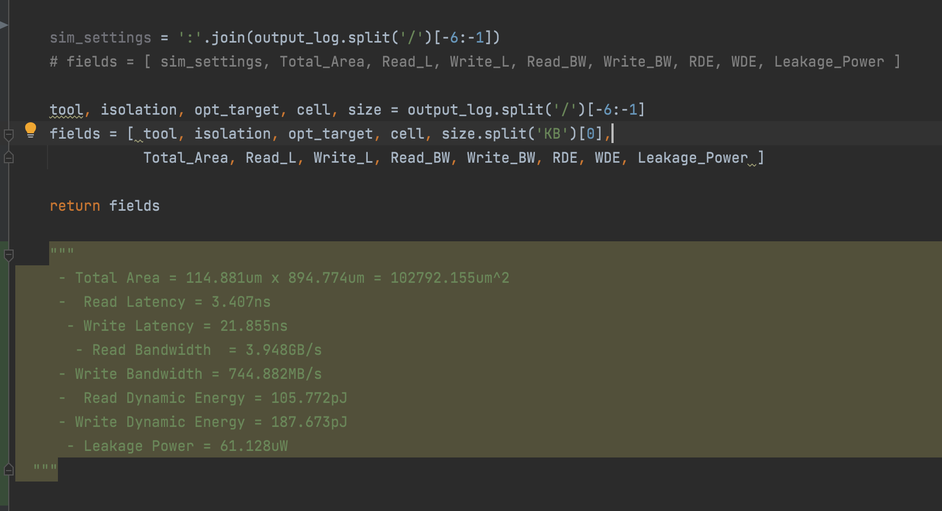
Step 3:
Parsing

Slide 9
Step 4:
Plotting (upcoming)

Slide 10
Performance and Hardware

Slide 11
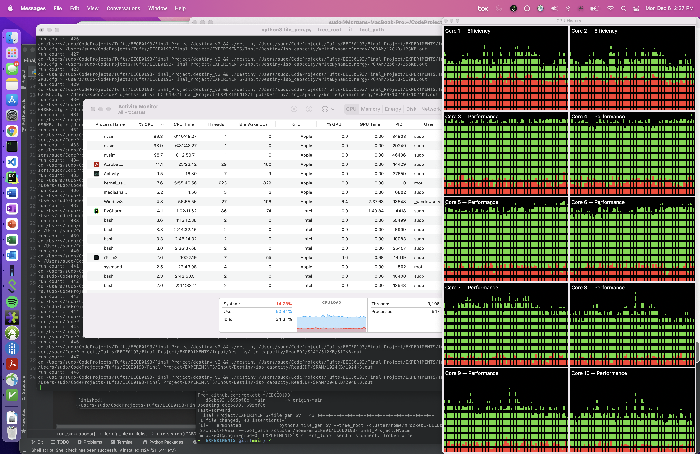
Performance: M1 Max[ed] out

Slide 12
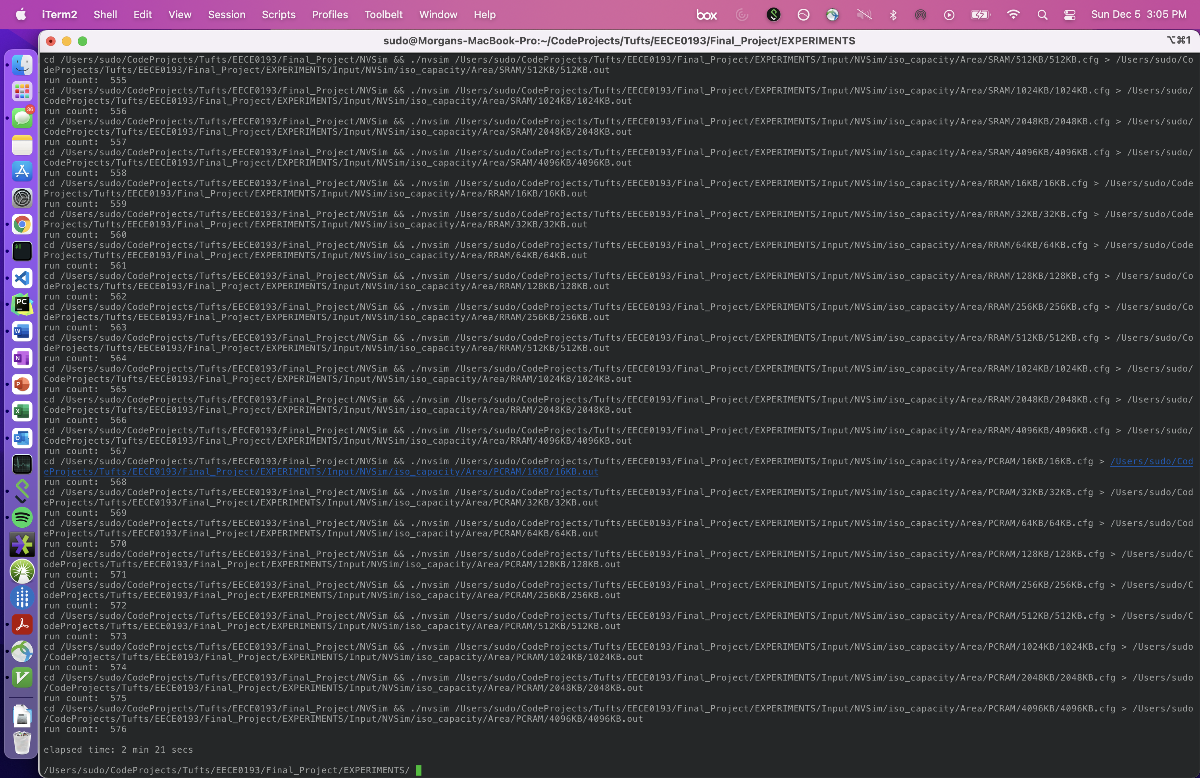
NVSim: 2min 21 seconds
Destiny: 9min 25 seconds

Slide 13
Results

Slide 14
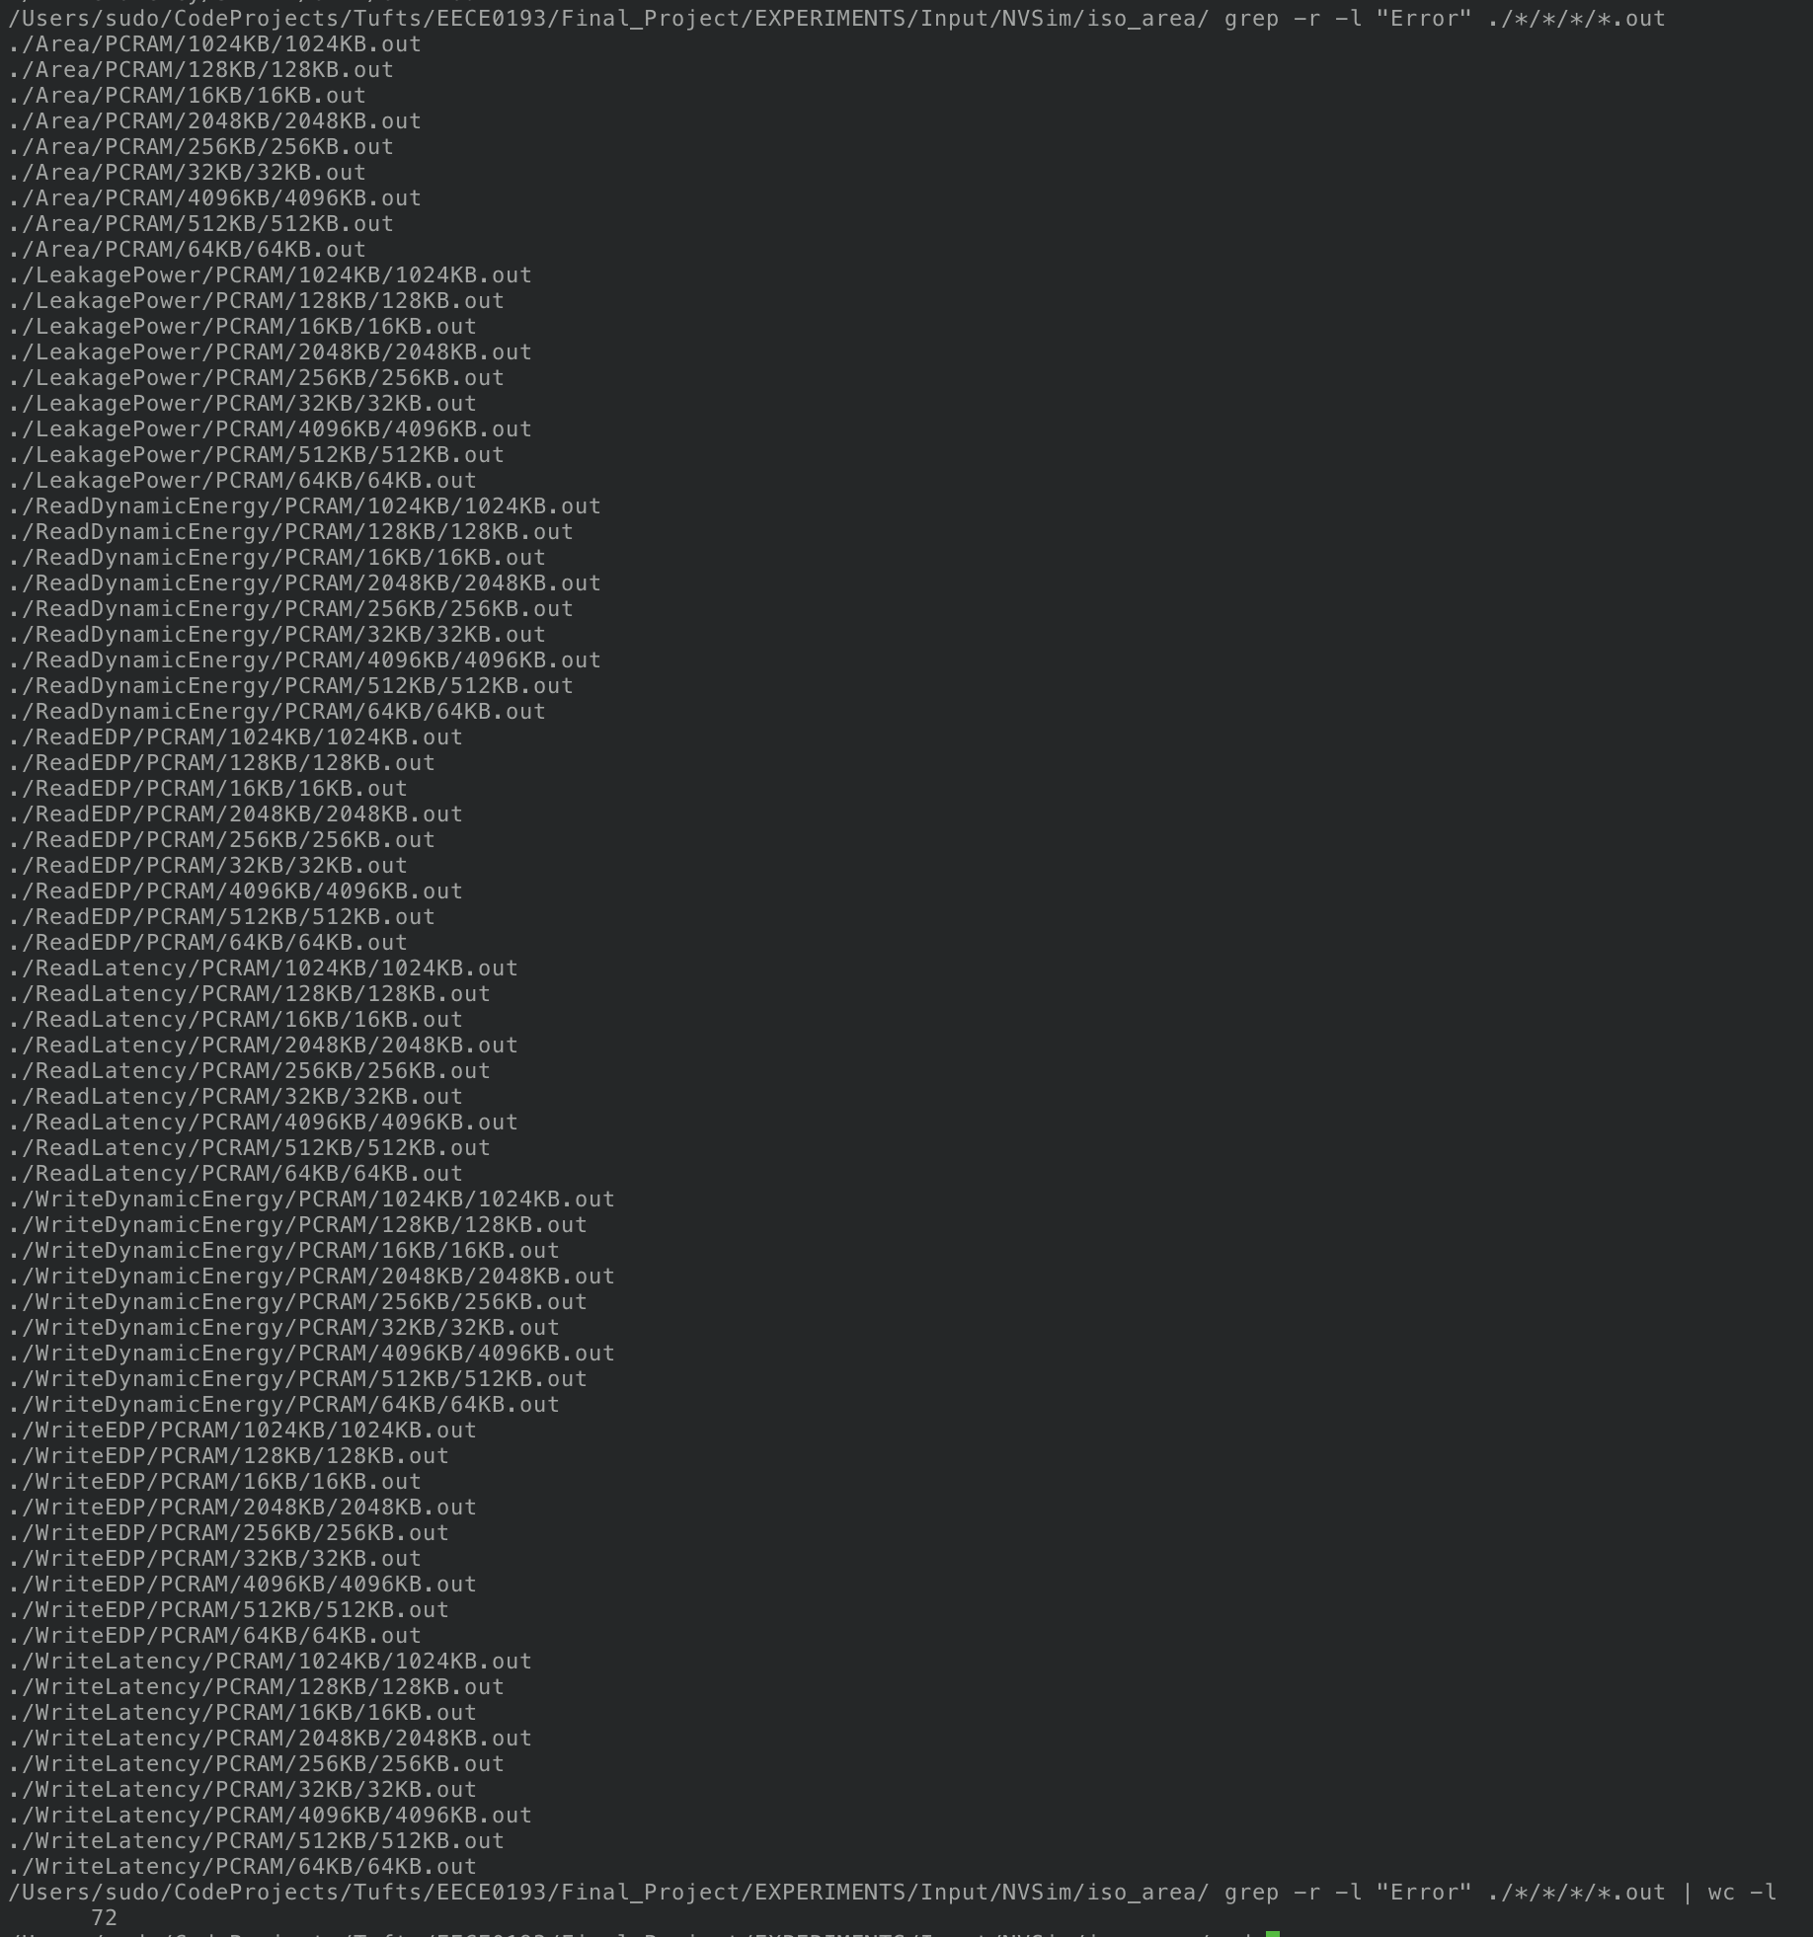
Dir Structure and Errors

Slide 15
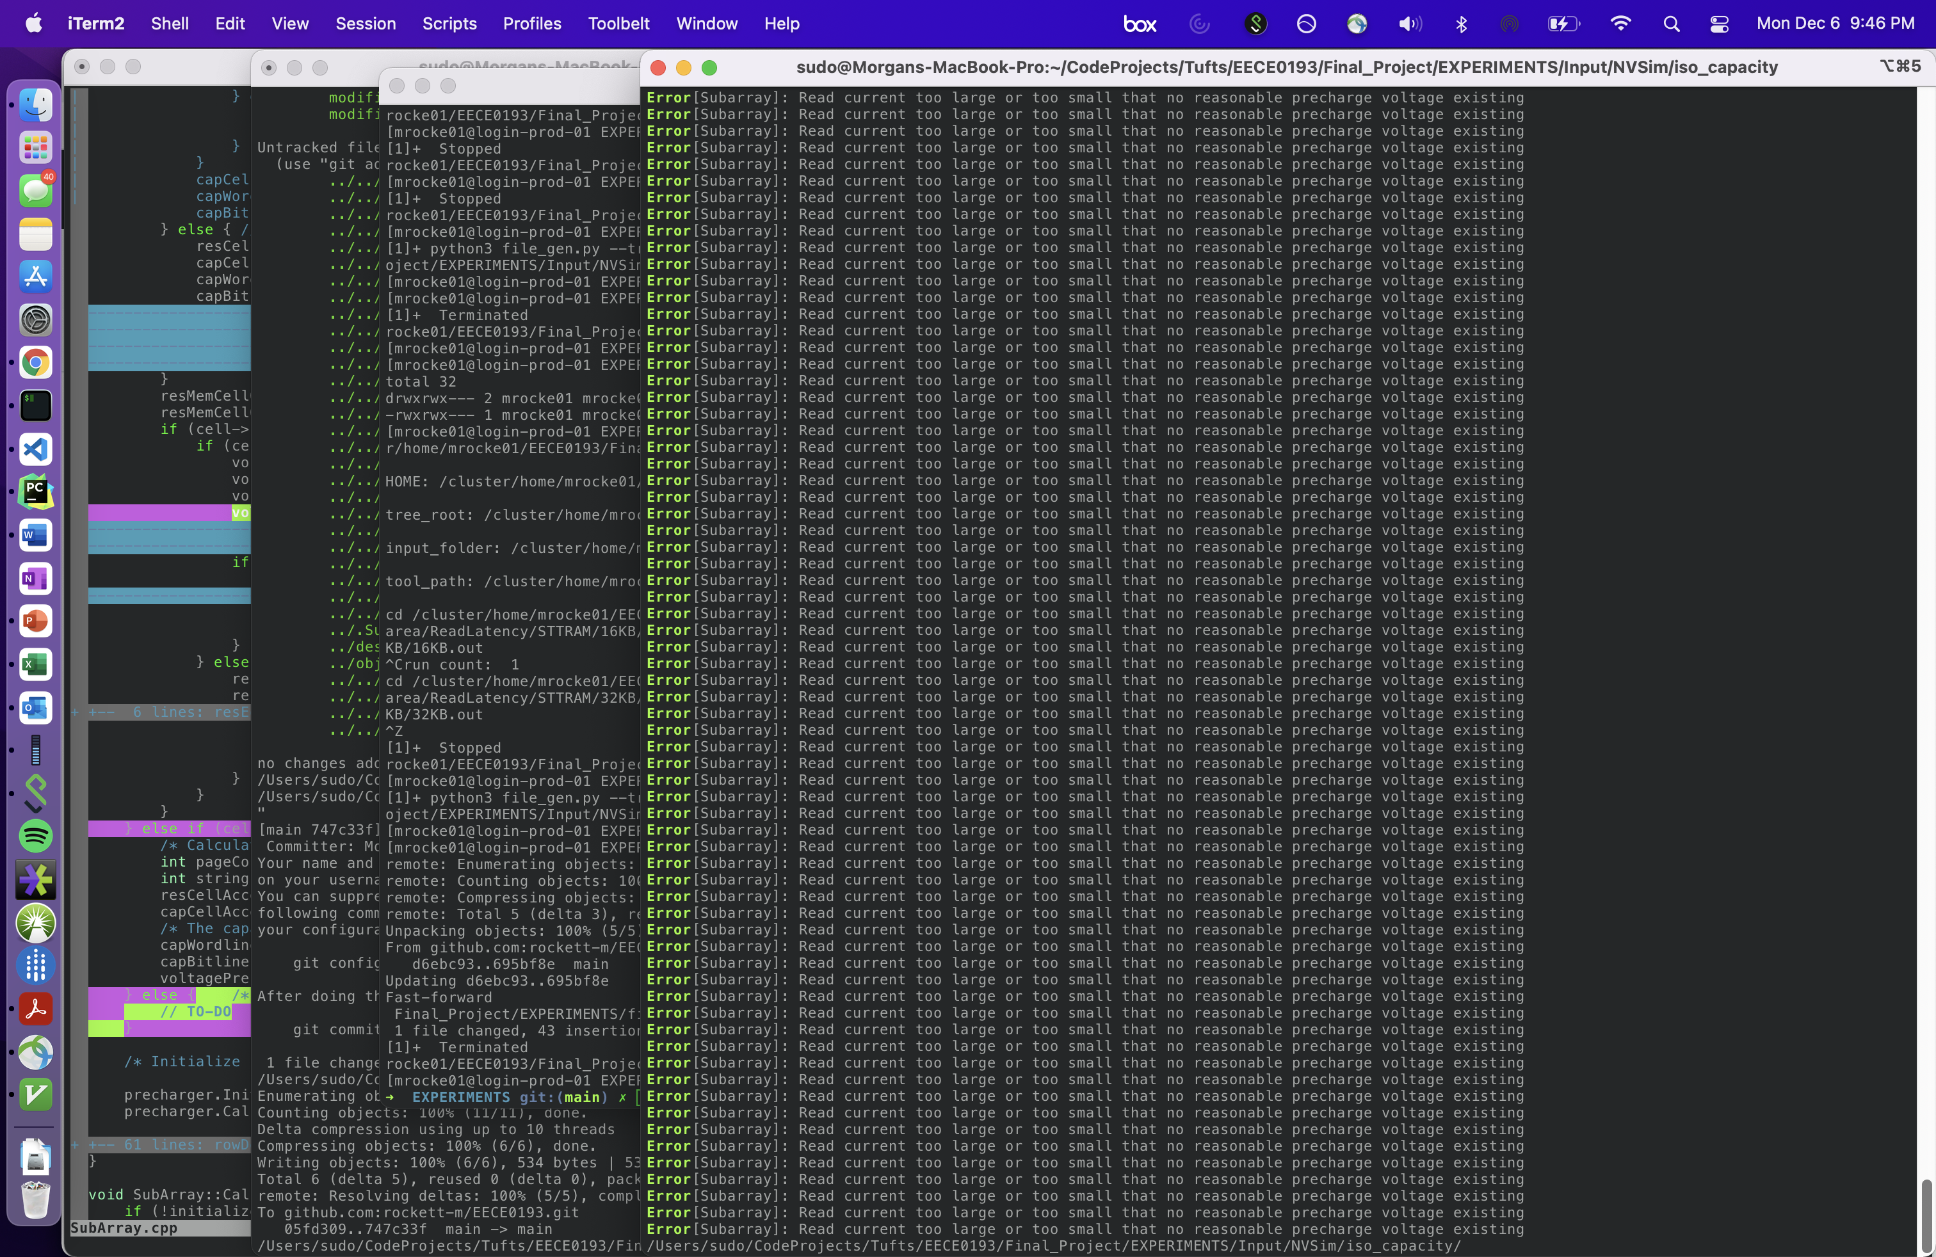
Errors: PCRAM

Slide 16
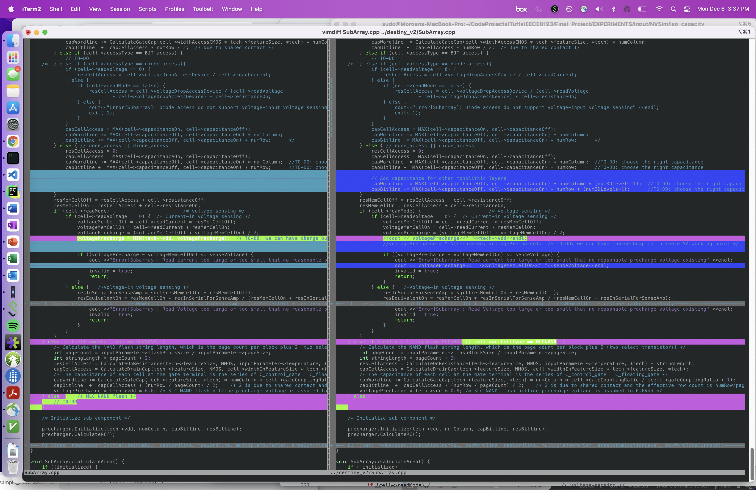

Slide 17
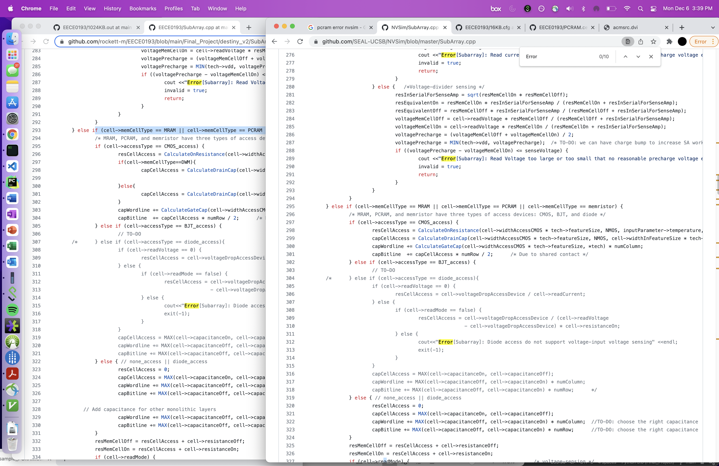

Slide 18
Data

Slide 19
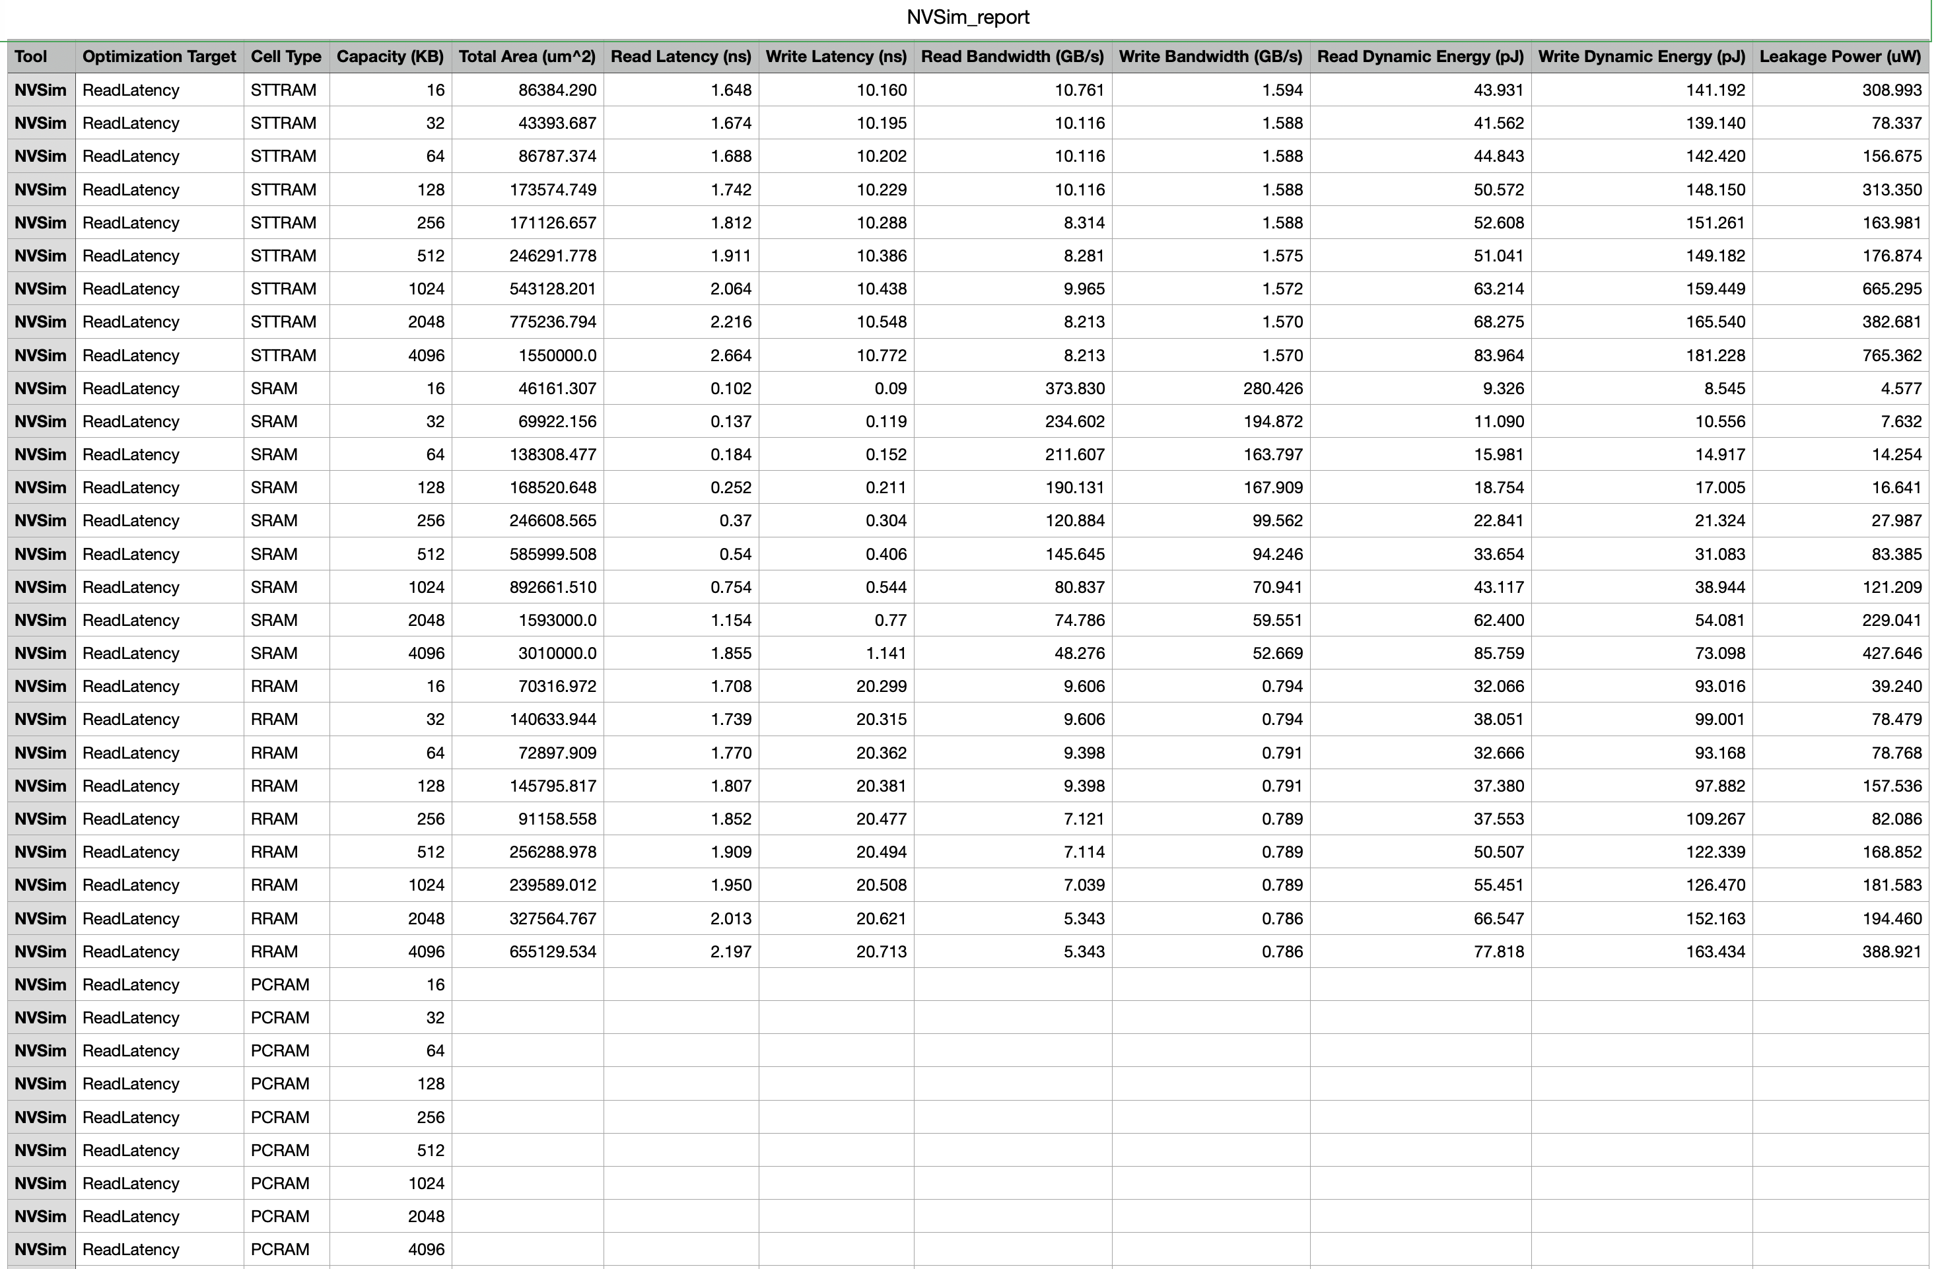

Slide 20
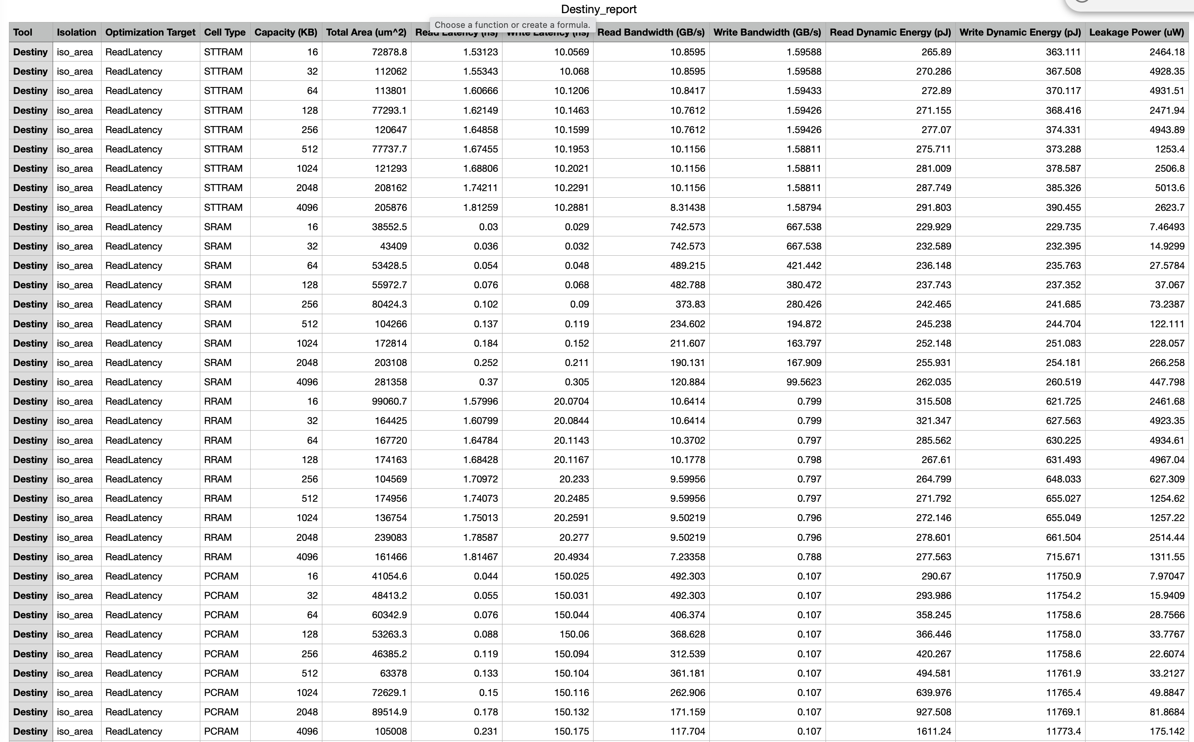

Slide 21
Area optimization target

Slide 22
Area optimization target

Slide 23
Area optimization target

Slide 24
Questions?

